Slide 1

Emoji Prediction from Sentence using Deep Learning
By
Jannatul Ferdous Jannah (200103020003)
Sourov Dey (200103020026)
Fahima Akther Moni (200103020054)
Supervised by
Khadem Mohammad Asif Uz Zaman
Lecturer, Dept. of CSE
North East University Bangladesh

Slide 2


Introduction
Emoji’s are a small visual representation of emotions or objects that are usually used in text messages to enhance the communication experience between individuals. The combination of text and emojis to improve emotion has become an essential part of how people communicate in the 21st century.
Goal: We are going to build a deep learning model that will predict the emoji from your sentence.

Slide 3




Background Study
Emoji Prediction from Twitter Data using Deep Learning Appraoach
V N Durga Pavithra Kollipara, V N Hemanth Kollipara, M Durga Prakash
Used method: Naïve Bayes, SVM, Bi-LSTM
Accuracy: 27%(Naïve Bayes), 29%(SVM), 89%(Bi-LSTM)
Using Neural Networks to Predict Emoji Usage from Twitter Data
Luda Zhao, Connie Zeng
Used method: LSTM, CNN
Accuracy: 37%(LSTM), 40%(CNN)

Slide 4

Background Study
Context-Aware Emoji Prediction Using Deep Learning
By Anushka Gupta, Bhumika Bhatia, Diksha Chugh, Gadde Satya
Used method: LSTM, BERT.
Accuracy: 72.99%(BERT), 66.66%(LSTM)
Emojify: Emoji Prediction from Sentence
By Chen Huang, Xueying (Shirley) Xie, Boyu (Bill) Zhang
Used method: Multinomial Naïve Bayes, SVM, Bi-LSTM
Accuracy: 19%(Multinomial Naïve Bayes), 16%(SVM), 15%(Bi-LSTM)
Emoji Prediction with Transformer Models
By Wenna Qin, Jiacheng Ge
Used method: GPT-2, BERT.
Accuracy: 76%(BERT), 75%(GPT-2)

Slide 5
Work-Flow
Data Collection
Data Cleaning and Pre-Processing
Data Analysis
Results
Building the Models
Word Tokenization
Removal of Stop Words

Slide 6
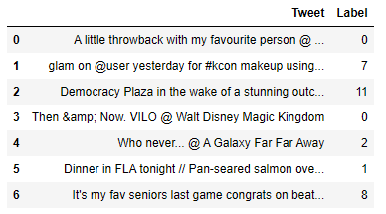
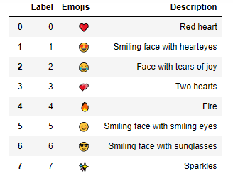

Sample Dataset
Word Tokenization
Removal of Stop Words
This dataset contain 20 different emojis and almost 50000 data in total.

Slide 7
Cleaning Data
Cleaning Data Includes:
Converting the whole text into lowercase
Removal of hashtag symbols (#), user mentions (@user) , retweet tags(RT).
Removal of hyperlinks or any HTML elements
Removing numbers
Removing punctuations

Slide 8
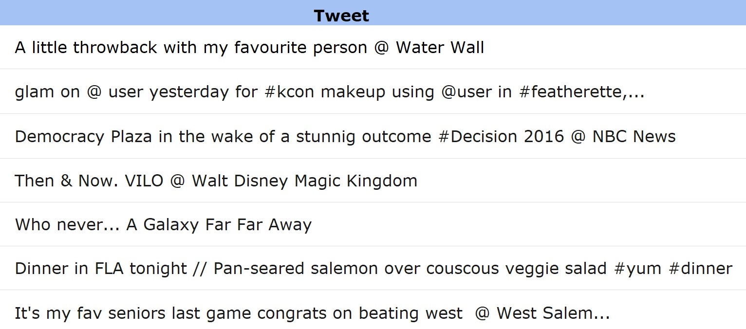
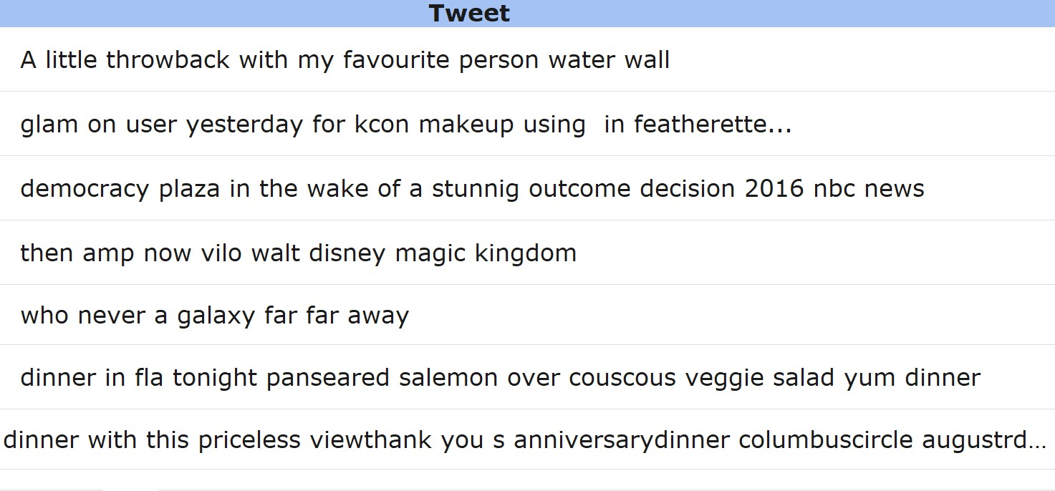
Before Cleaning Data:
After Cleaning Data:

Slide 9
Pre-Processing Data
Data Pre-processing includes:
Removal of Stop words
Tokenization
Lemmatization
Feature Extraction (Converting text data into Numbers)

Slide 10
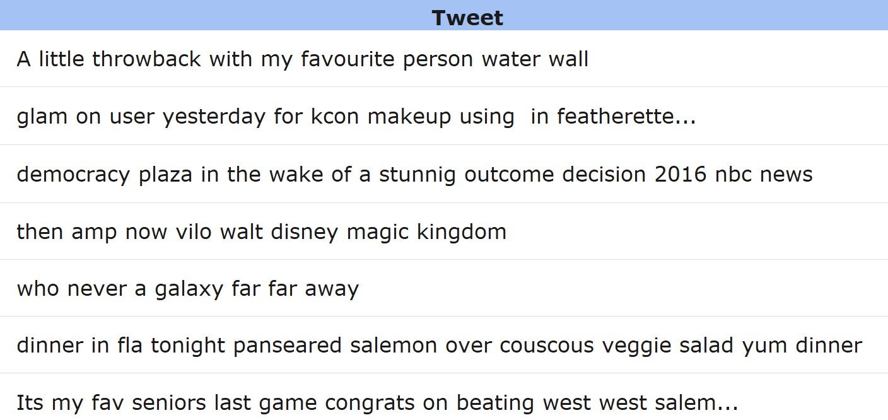
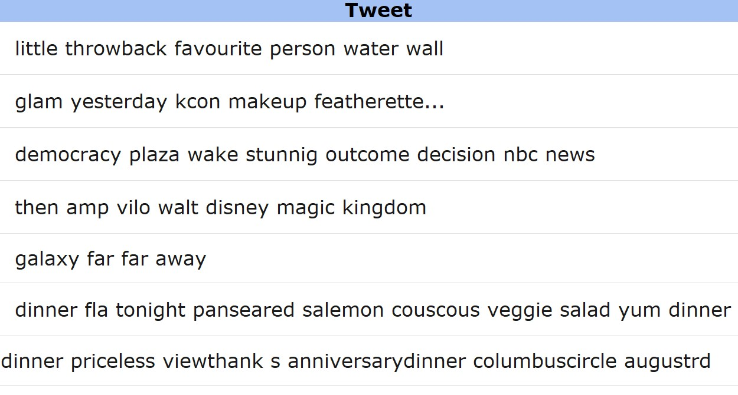
Before Pre-processing:
After Pre-processing:

Slide 11
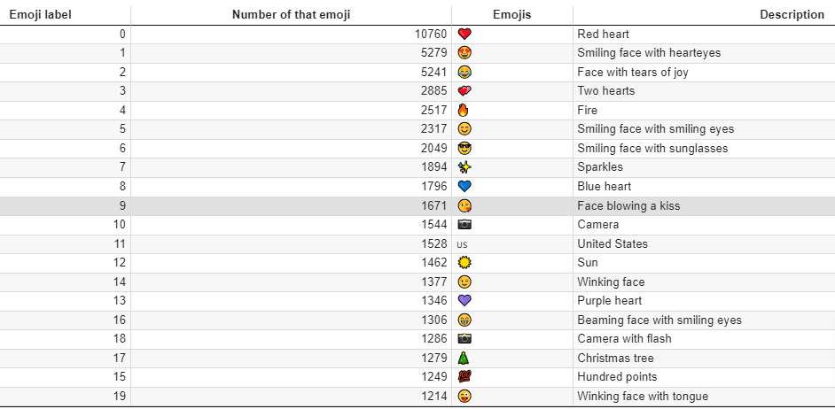
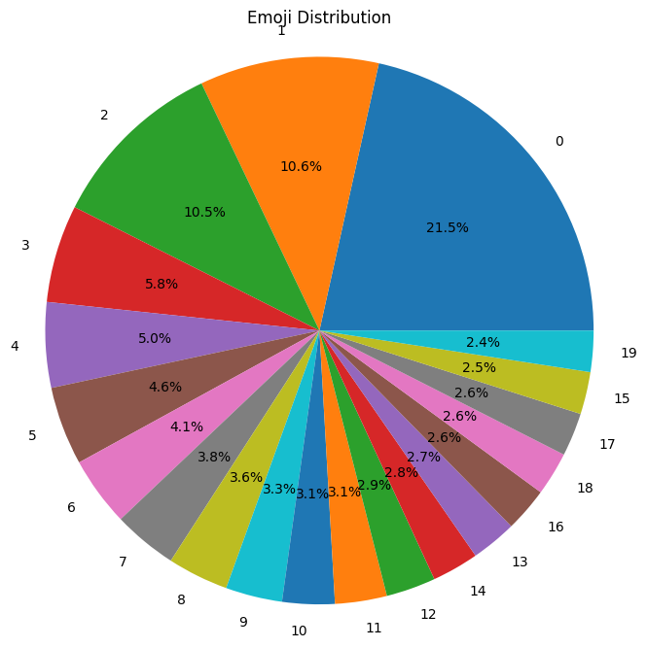
Data Analysis

Slide 12
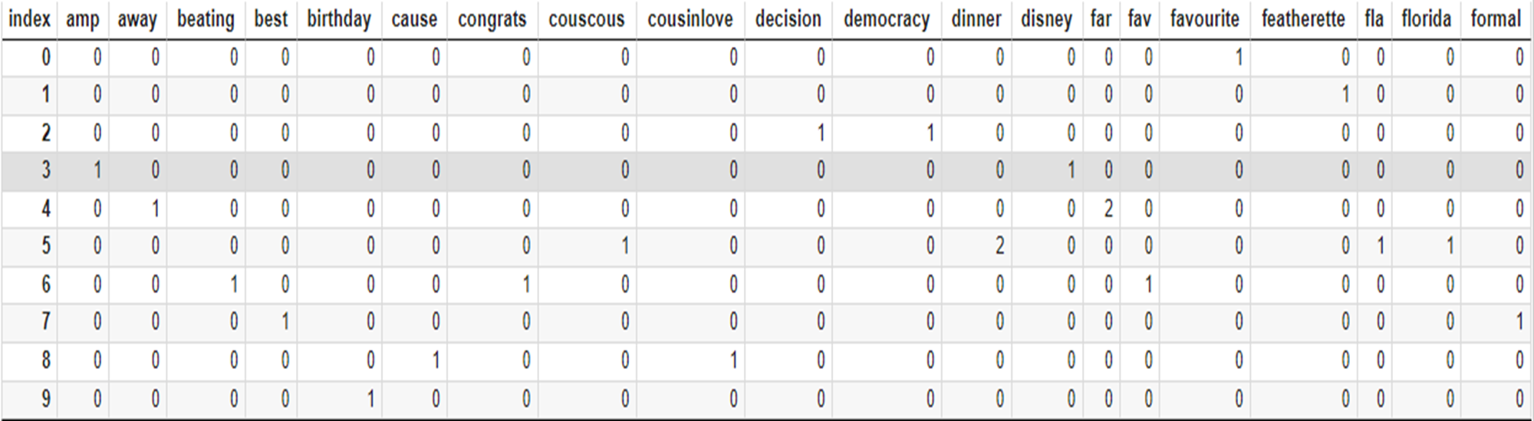
Sample Text feature extraction

Slide 13


Multinomial Naïve Bayes
Support Vector Machine
Accuracy | Precision | F1-Score | Recall
28% | 29% | 19% | 28%
Accuracy | Precision | F1-Score | Recall
30% | 32% | 21% | 30%

Slide 14
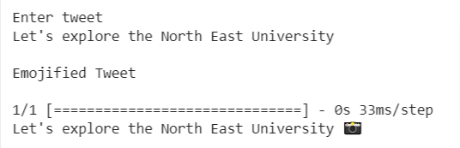
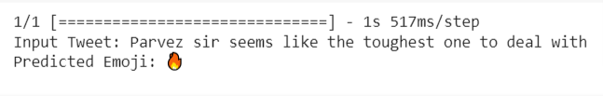
Long Short Term Memory
Gated Recurrent Unit
Accuracy | Precision | F1-Score | Recall
88% | 87% | 87% | 88%
Accuracy | Precision | F1-Score | Recall
63% | 70% | 66% | 63%

Slide 15
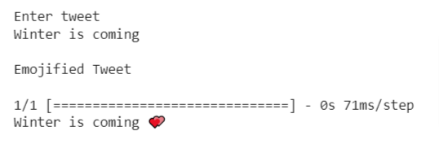
Bidirectional Long Short Term Memory
Accuracy | Precision | F1-Score | Recall
88% | 87% | 87% | 88%

Slide 16
Limitation
The project encounters several limitations primarily related to the dataset. Here are three of them:
Imbalance Dataset
The dataset contains a restricted collection of only 20 emojis
Imperfection in the mapping between tweets and assigned emojis

Slide 17

THANK YOU !
Happy Emojifying

